Slide 1
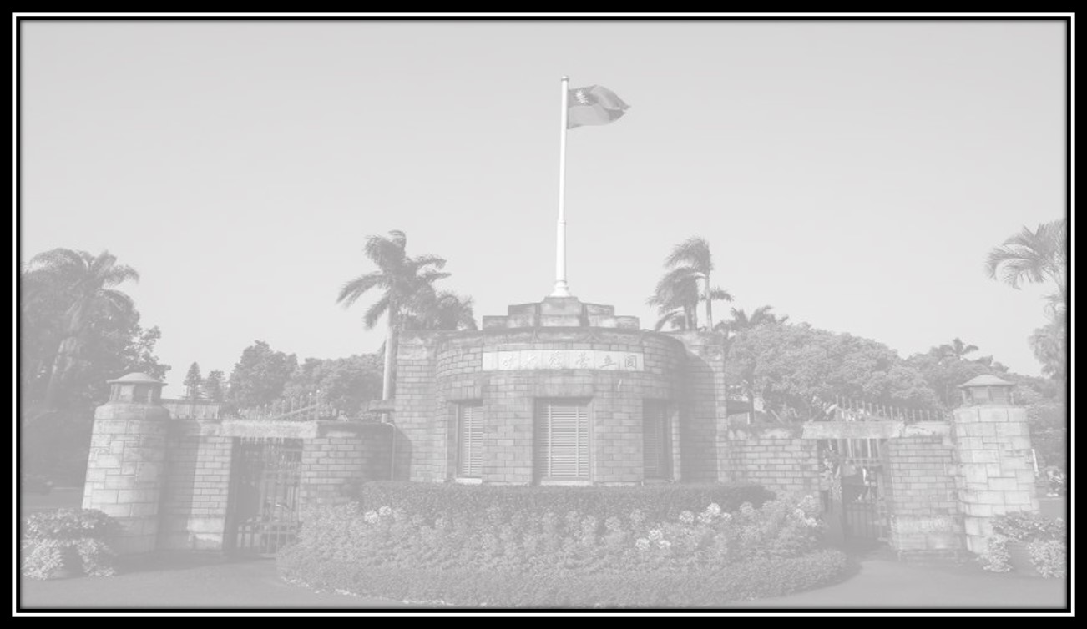

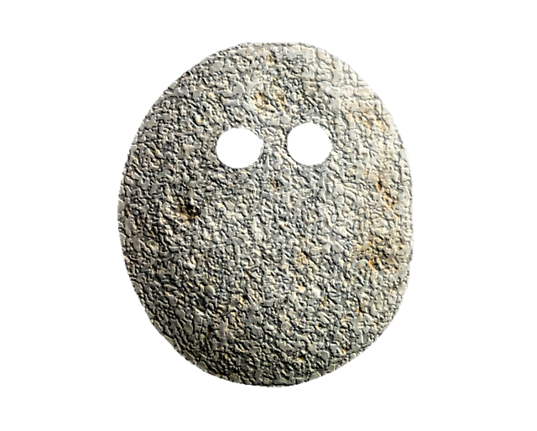



Simulation of Light Scattering and Propagation:
Homework: 3
The Rock
Ashish Gaurav(古希實) R09941125
Yu-Ting Chou(Steven) R10941128
Cheng-Ting Chen(Leon) R10945062
Prof. Snow H Tseng
2022/09/26

Slide 2

Question: Draw the trajectory of a rock falling from a Mountain?
Answer:
There are three ways by which one can simulate the rock falling from the mountain:
1.) Rock rolling uniformly from a step mountain (Case: 1)[Basic physics]
2.) Rock falling down through in a bouncing form from the top of mountain (Case 2)
3.) Rock rolling through a non-uniform random curvy mountain (Case 3)

Slide 3
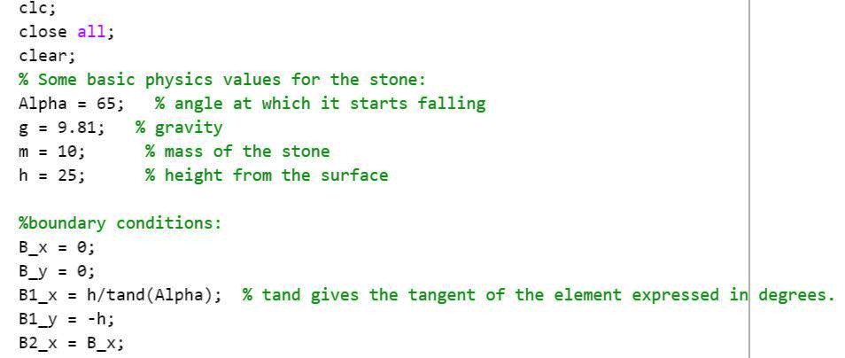
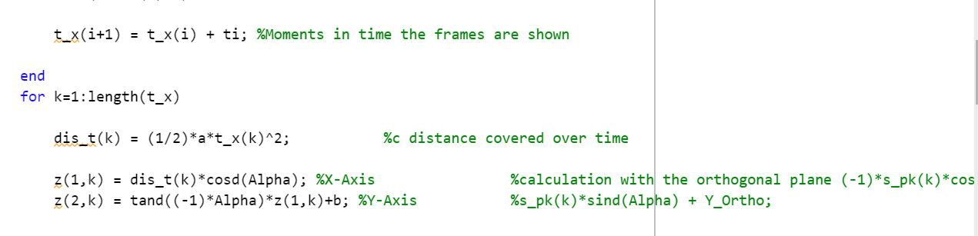
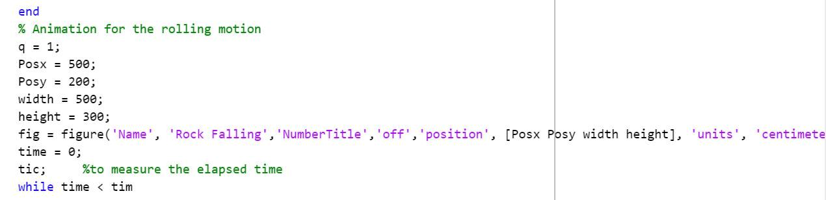
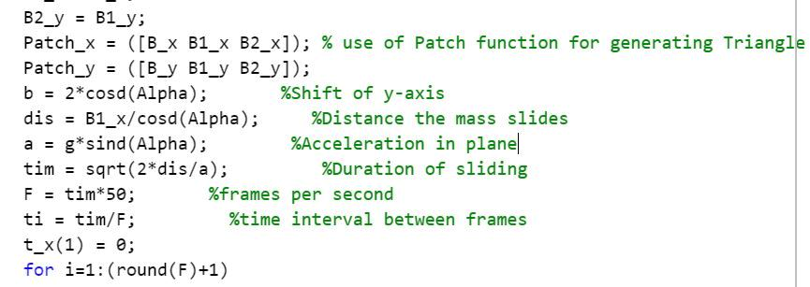
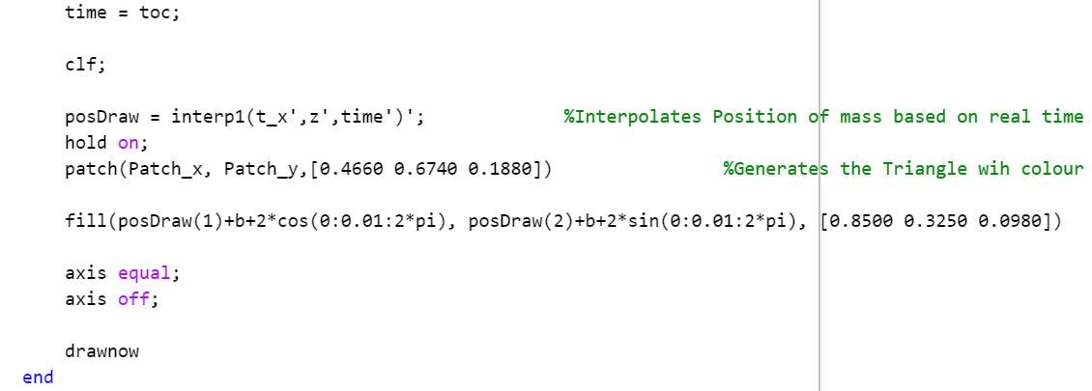
CASE: 1(Rock falling smoothly from the step mountain):
Fig 3. Distance covered over time
Fig 1. Setting newtons Law and boundary conditions
Fig 4. Setting the Animation of rolling motion
Fig 2. Setting Distance and frame
Fig 5. Simulate and fill the objects

Slide 4
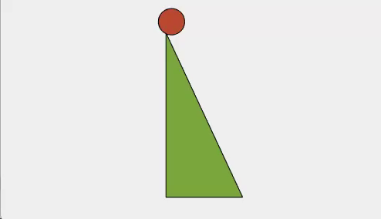
CASE: 1(Results)
Challenge:
Figure 1: Rock falling uniformly
Figure 2: Random edges in mountain
Main concept behind the rolling motion:
1.) Newtons law and use of gravity, acceleration, time travel by the rock, distance.
2.) Boundary conditions(Specially for making triangle)
3.) The determination of the frame rate for the falling rock(rock trajectory).
Challenge:
The rand function used to creation mountain edge with non-uniform motion

Slide 5
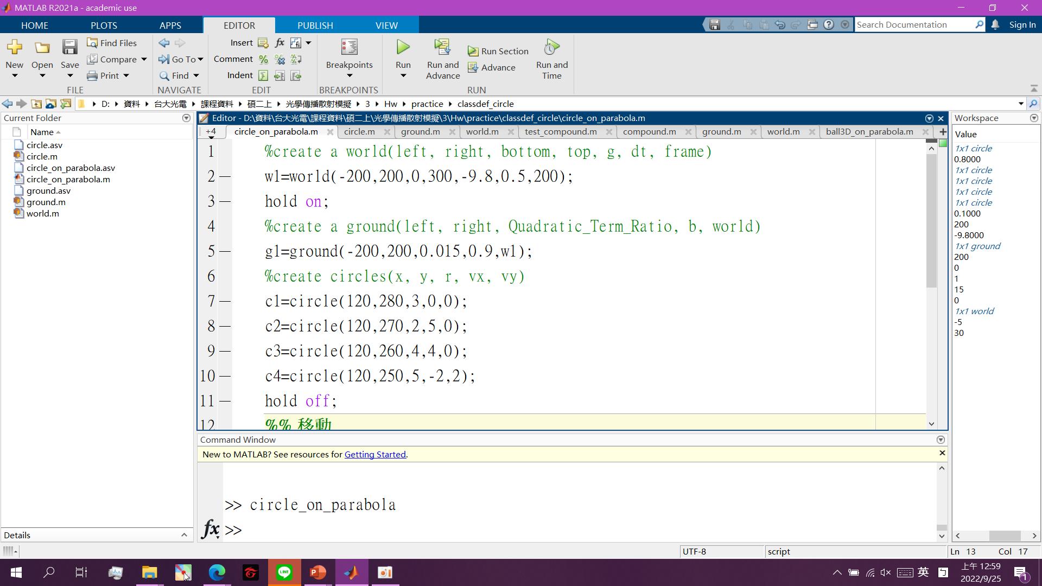
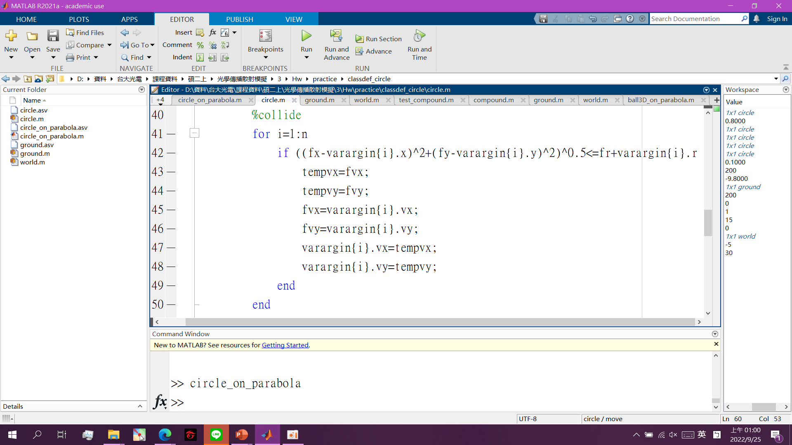
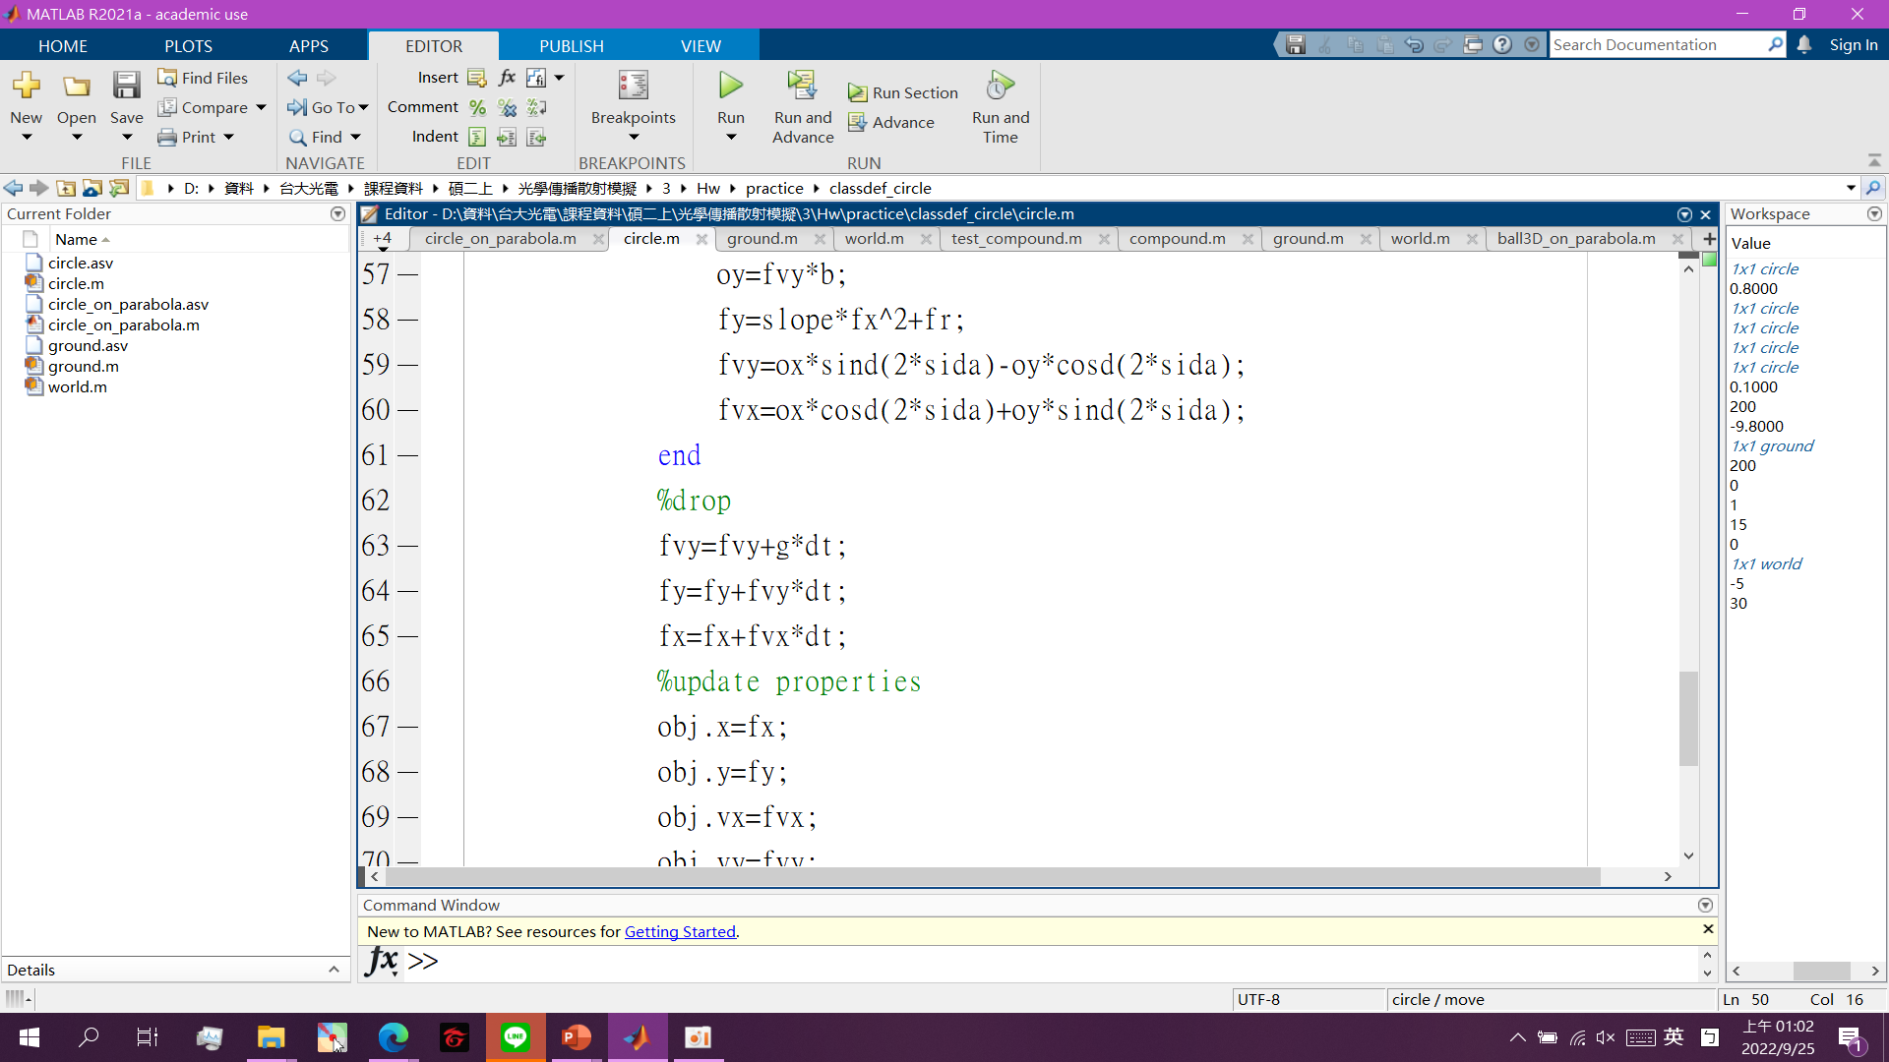
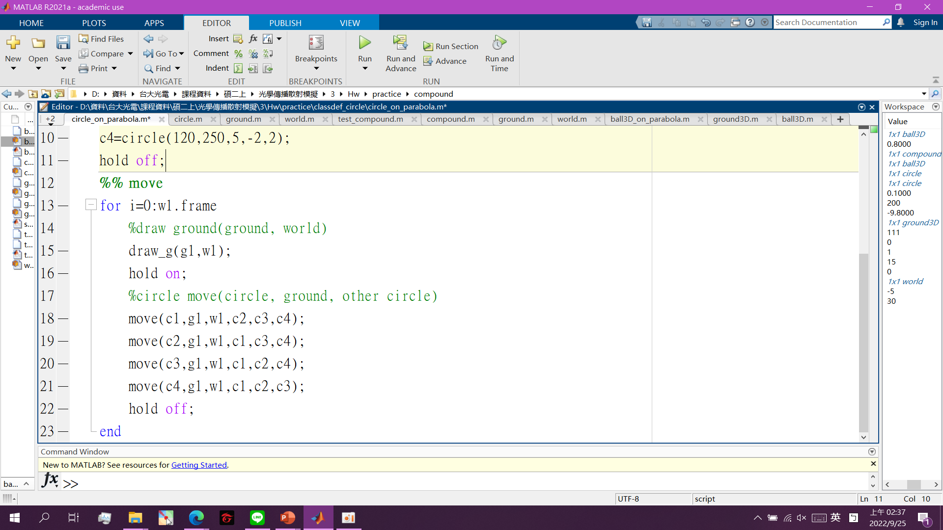
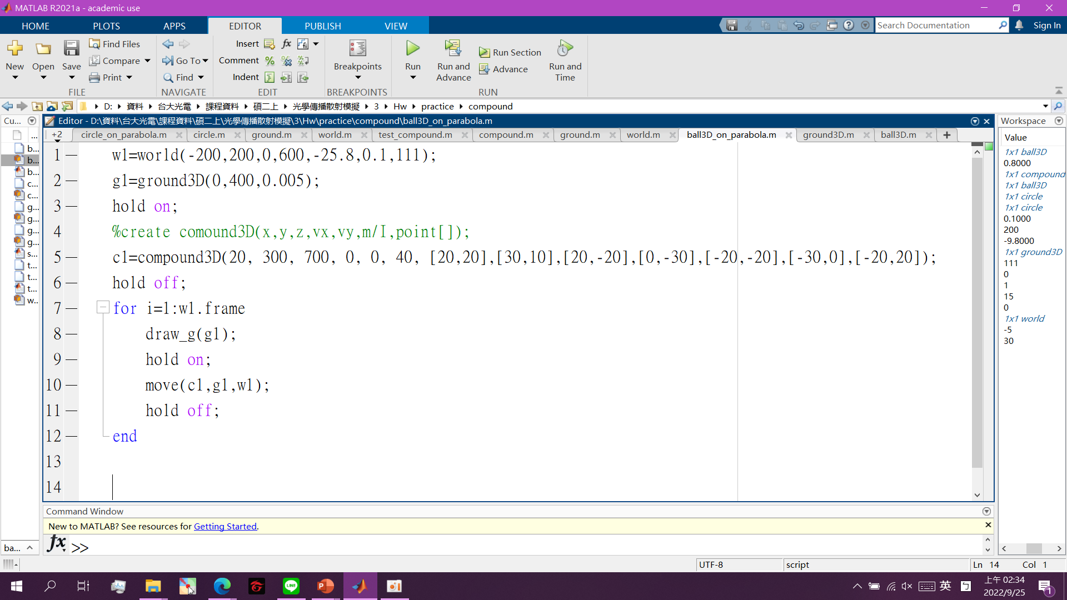
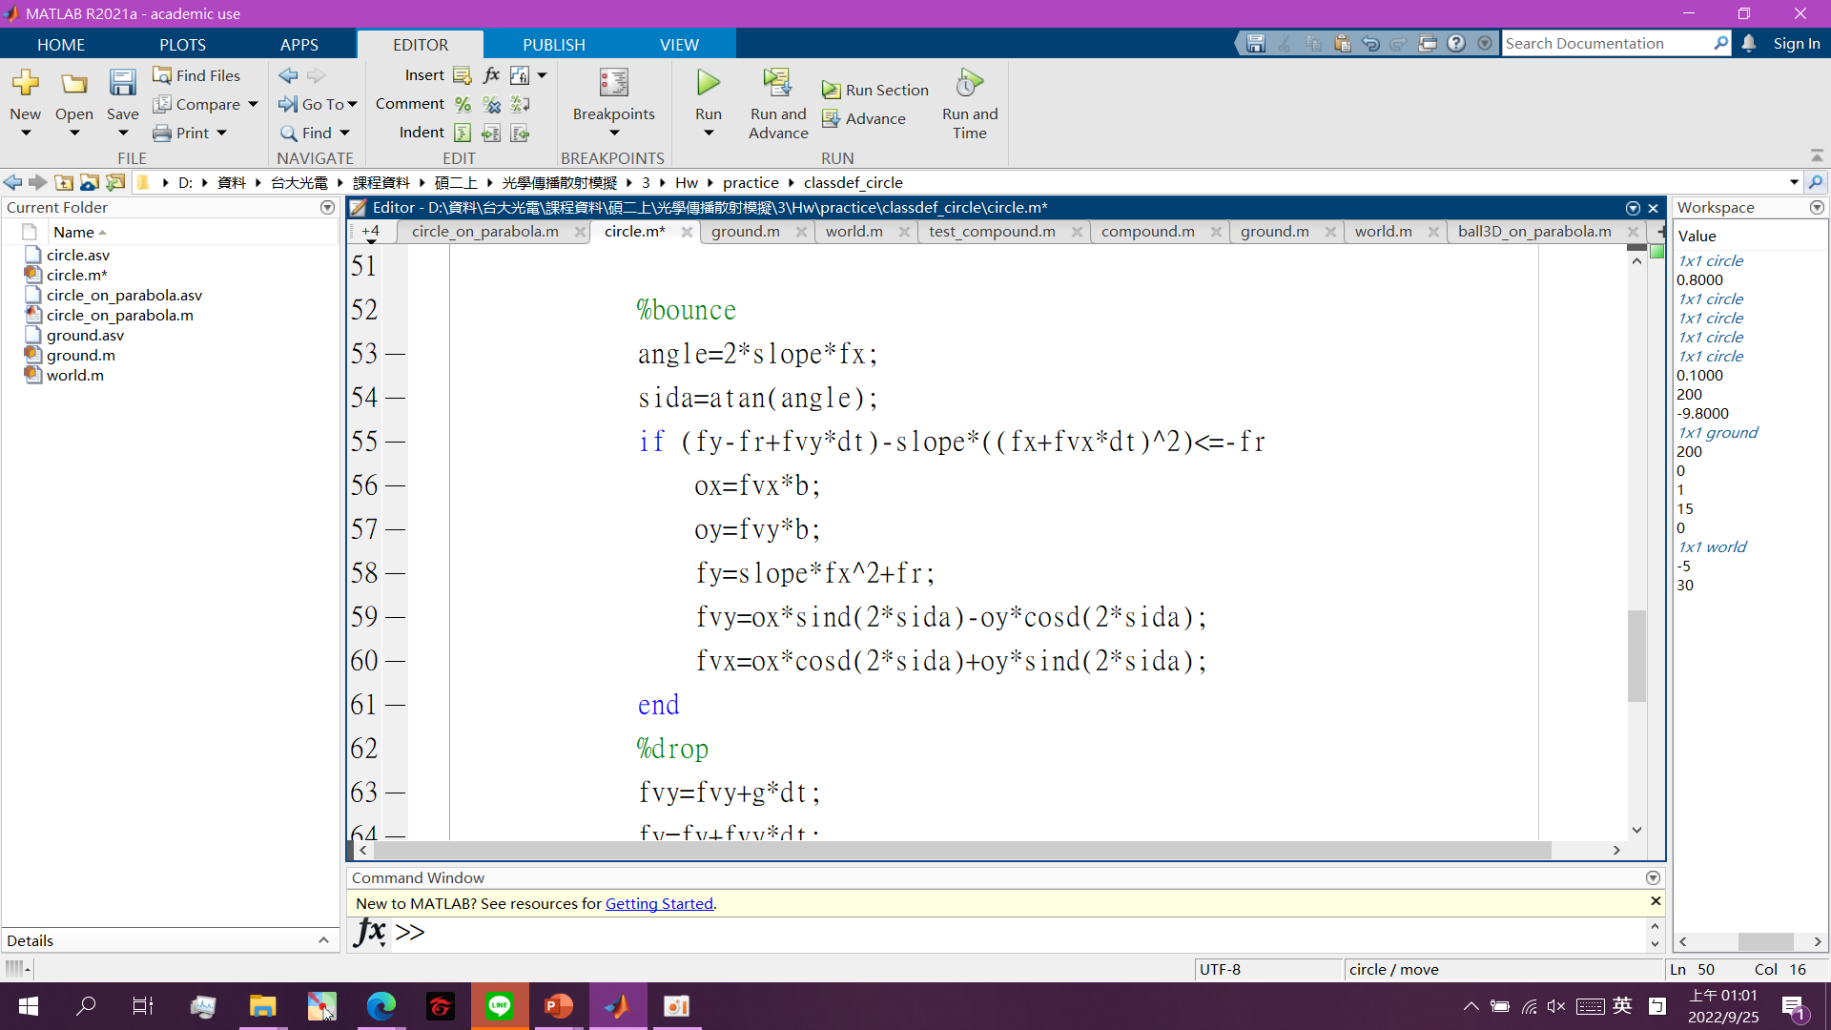
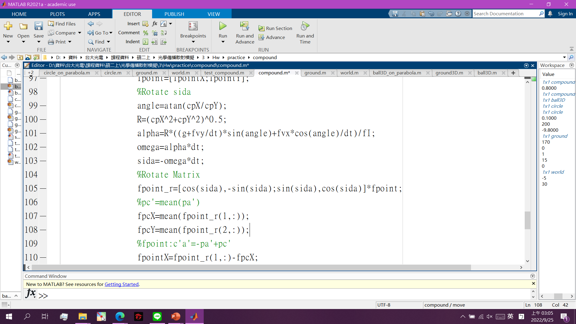
CASE: 2 (Bouncing motion of the rock on uniform surface):
Create Circle and environment
Collision of the ball
Motion of the circle
Creating a 3D environment
Bouncing of the circle

Slide 6
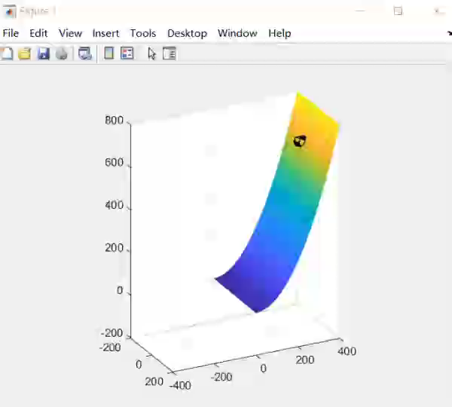
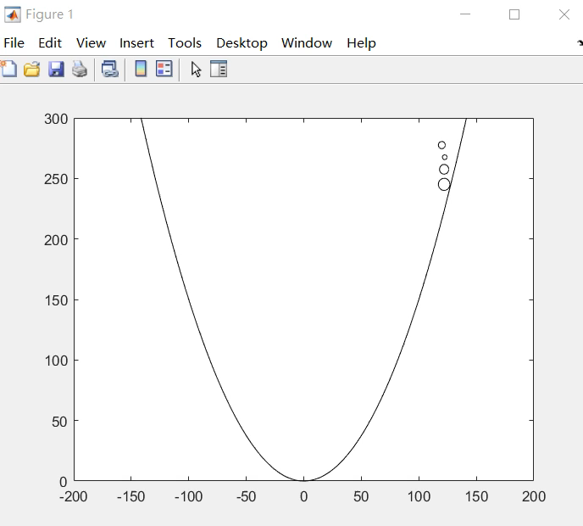
CASE: 2 Result (Bouncing motion of the rock on uniform surface):
Figure 3: Bouncing Rock from cliff
Figure 4: Bouncing Phenomena

Slide 7
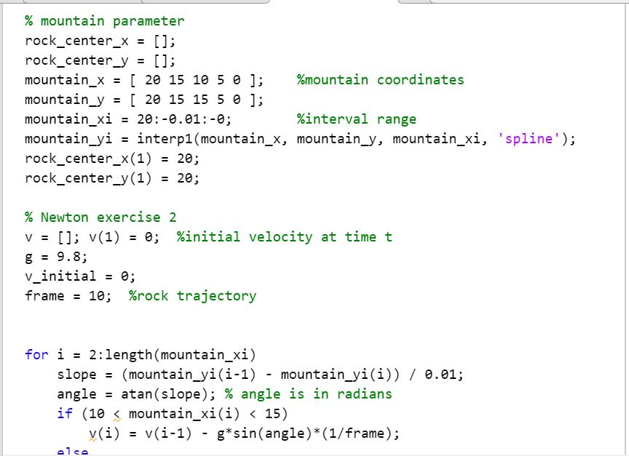
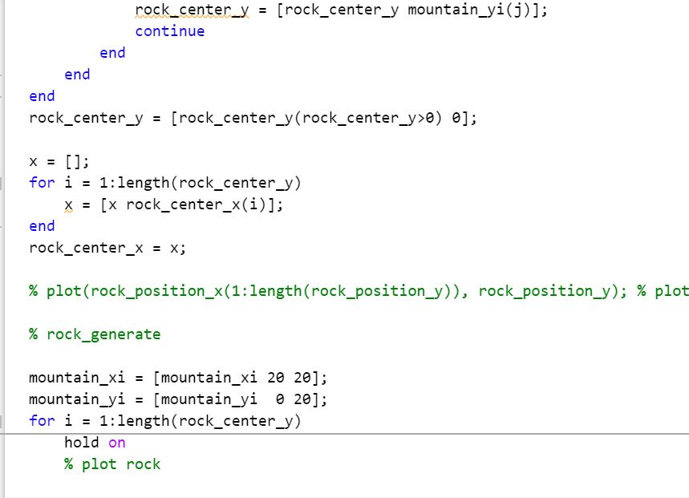
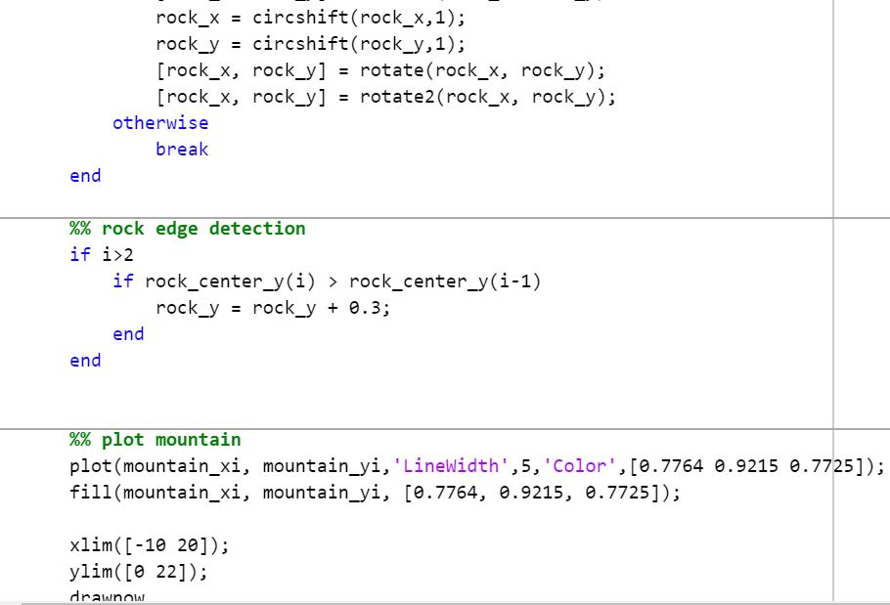
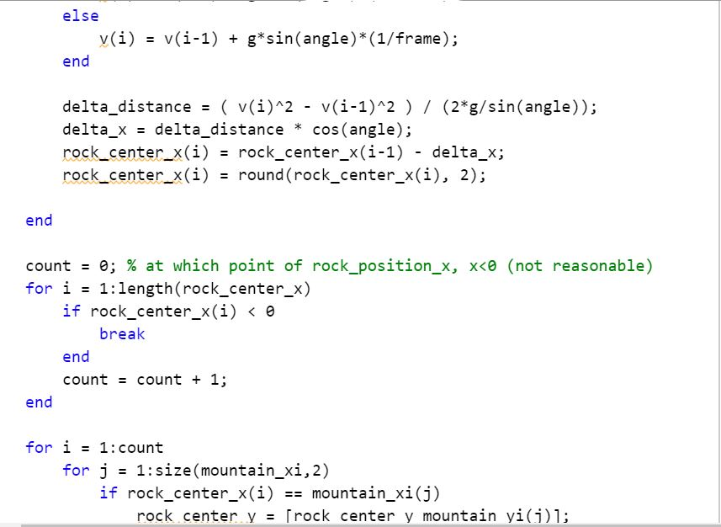
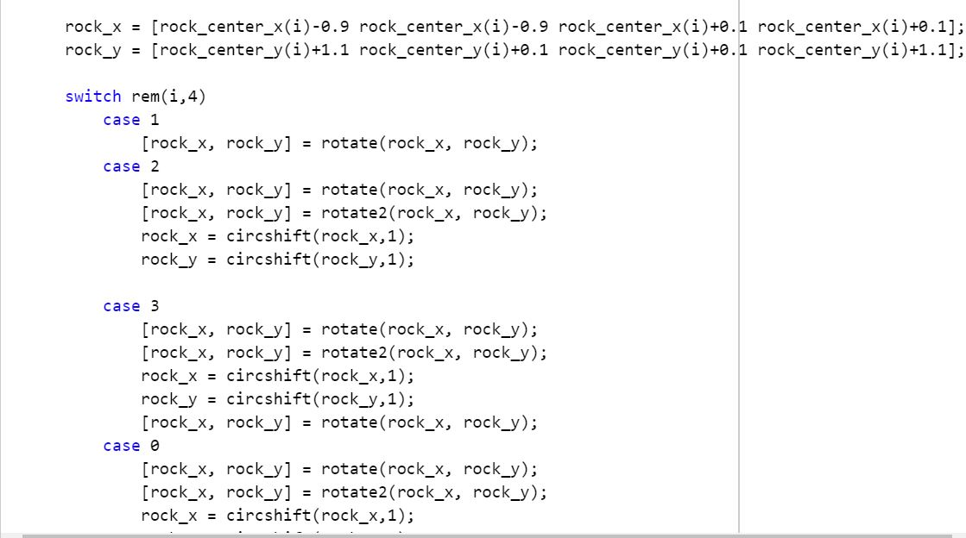
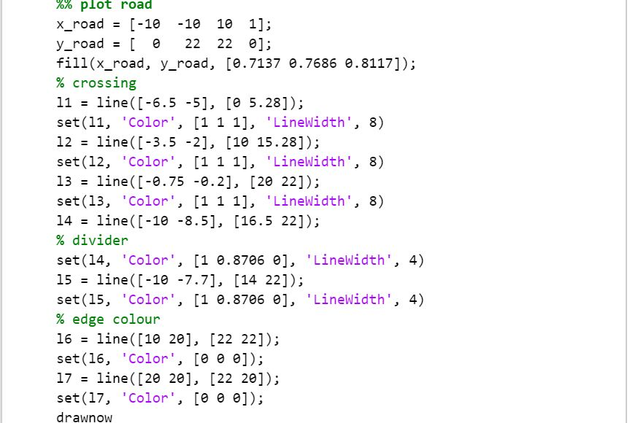
CASE: 3 (Rolling motion of the rock on non-uniform surface):
Fig 1. Setting newtons Law and boundary conditions
Fig 3. Plotting rock and its generation
Fig 5. Rock end point and edge detection and mountain plot
Fig 2. Initiating rock position
Fig 4. Different cases for rock rolling
Fig 6. Plotting rock

Slide 8
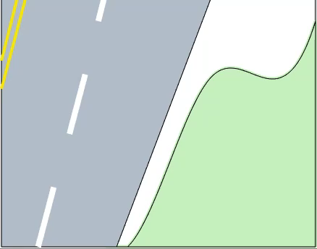
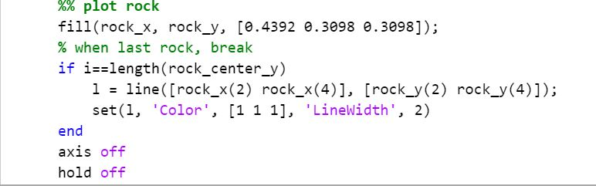
CASE: 3 Results (Rolling motion of the rock on non-uniform surface)
Fig 7. Plotting rock
Figure 5: Rock falling from non-uniform mountain cliff with a rolling

Slide 9
Thank You!!

